Slide 1

Analyzing Road Safety and Collision Trends in Greater Toronto Area
A Comprehensive Examination of Traffic Accidents and Contributing Factors
BY: Karan Punjabi
N01514624

Slide 2
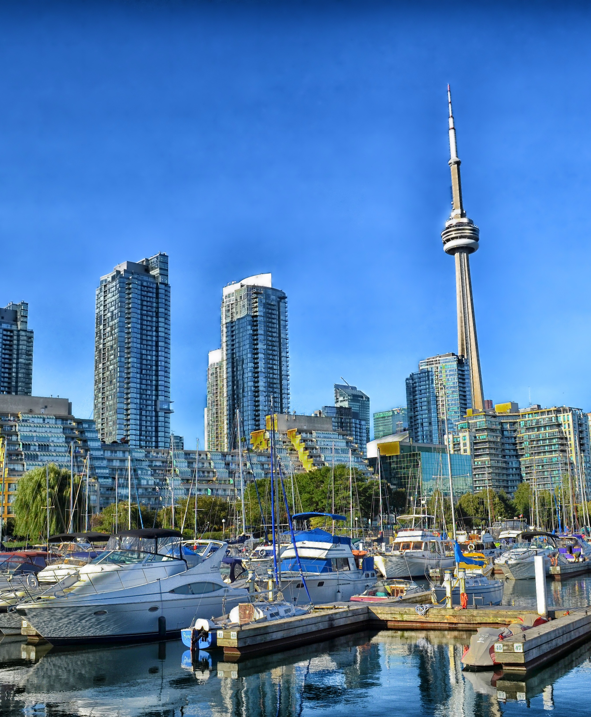
Introduction
Road safety is a critical concern for any urban area, and Toronto is no exception. This project aims to analyze and gain insights into traffic accidents within the city over the past years. By studying the dataset of road collisions, we aim to identify patterns, primary causes, and high-risk areas, ultimately leading to data-driven strategies for improving road safety.

Slide 3

Dataset Overview:
The dataset used for this analysis contains detailed information on road collisions in Greater Toronto Area. It includes unique identifiers for each accident, along with various attributes such as date, time, location, road classification, and city district. Additionally, the dataset provides crucial insights into accident characteristics, involvement types, severity of injuries, and contributing factors like speeding, distracted driving, and alcohol-related incidents.

Slide 4
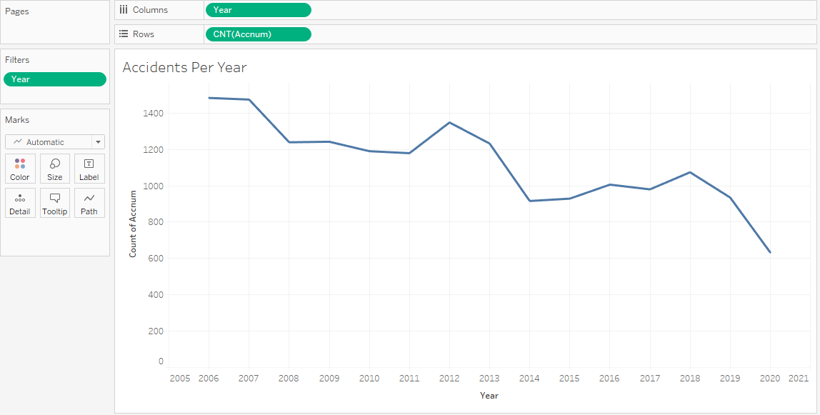
Accident per Year.

Slide 5
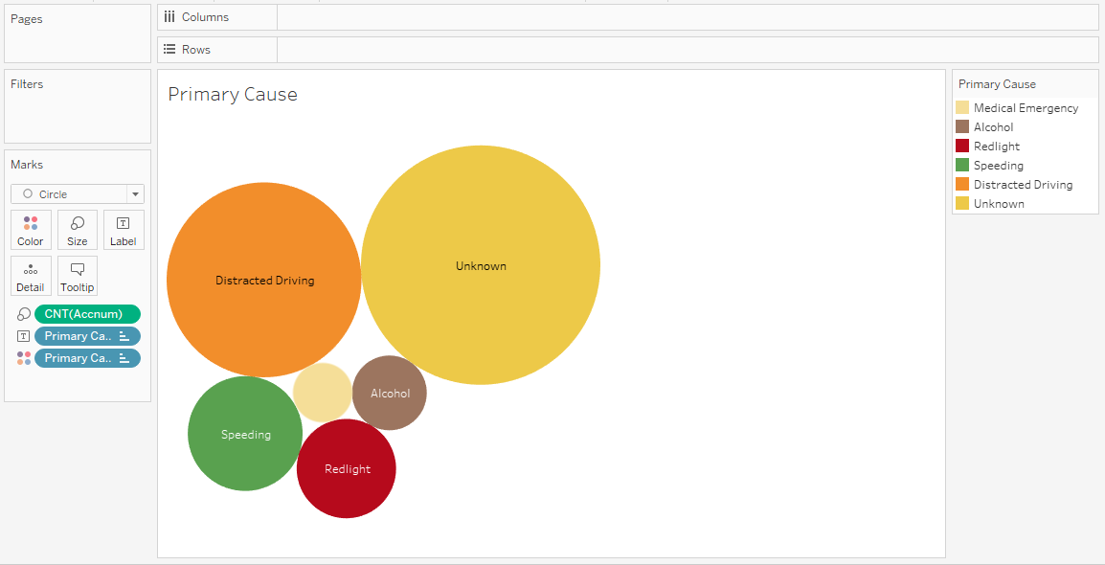
Primary Cause

Slide 6
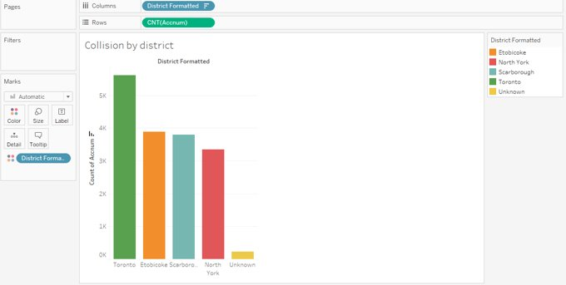
Collision by District

Slide 7
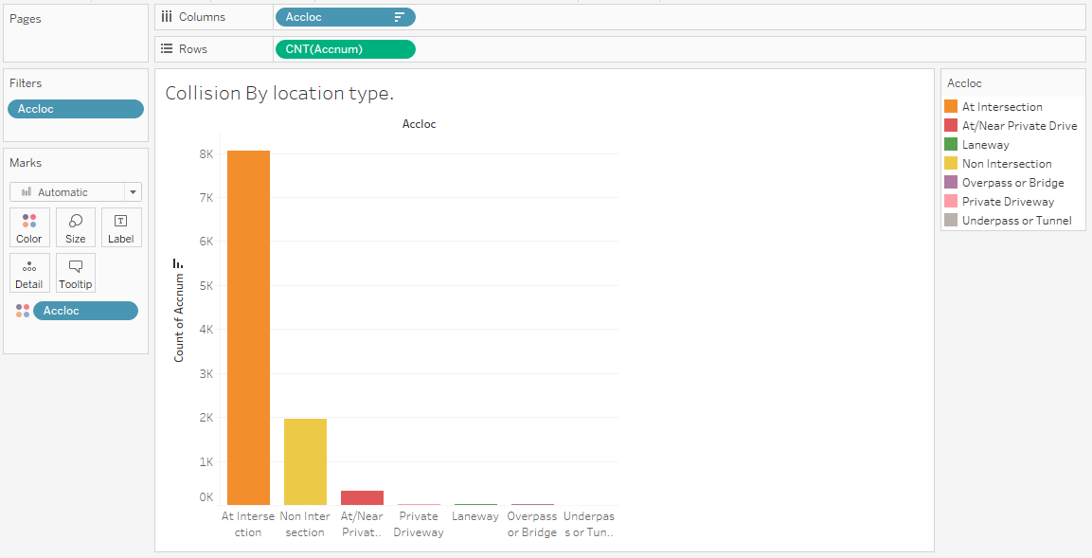
Collision by location type.

Slide 8
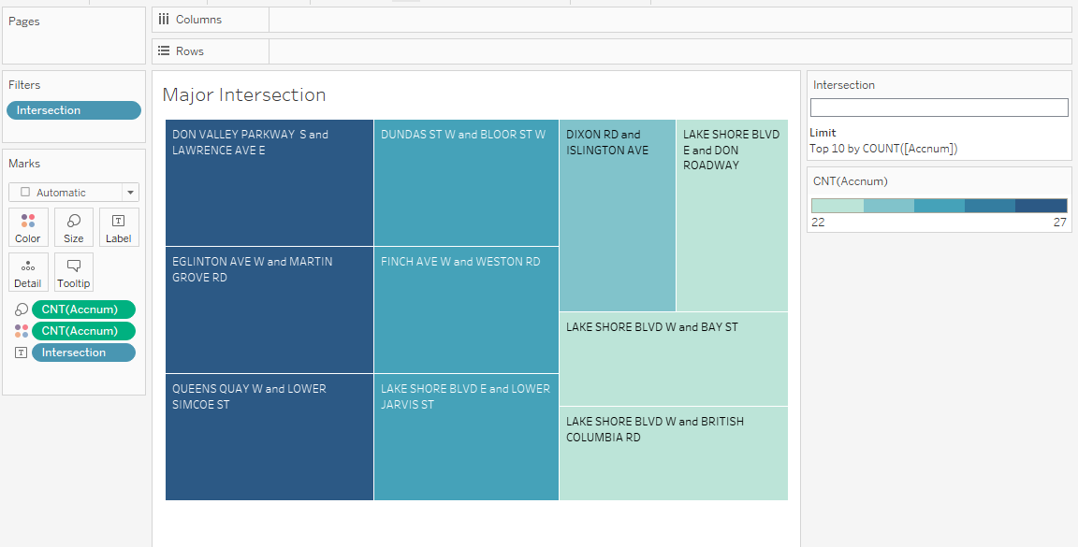
Major Intersection

Slide 9
Recommendations:
Based on the analysis, the following recommendations are proposed to enhance road safety in GTA:
Continue implementing and monitoring road safety initiatives to sustain the declining trend of accidents.
Allocate resources to address road safety challenges in high-accident cities, with a particular focus on Toronto.
Launch comprehensive campaigns to combat distracted driving, aiming to raise awareness and change driving behaviors.
Collaborate with local authorities and stakeholders to target the top 10 high-risk intersections and devise tailored safety solutions.

Slide 10
Conclusion
In conclusion, by analyzing accident trends, causes, and locations, we can work towards creating a safer road environment for all residents and visitors. The findings and recommendations can guide policymakers and authorities in formulating effective strategies to improve road safety and reduce accidents in Toronto.
Thank you!

Slide 11

Questions?

Slide 12

Thank you

